Slide 1
Version Control

Slide 2
What you will learn today
What version control is
Why you need it (or maybe you don’t?)
Session 1: Git basic concepts
Session 2: remote repository
Session 3: team working
Source Tree and command line
Up and running with tools and account

Slide 3
What is version control?
‘Version control is a system that records changes to a file or set of files over time so that you can recall specific versions later’
Great free book: https://git-scm.com/book/en/v2
Excellent Atlassian tutorial: https://www.atlassian.com/git/tutorials/what-is-version-control

Slide 4
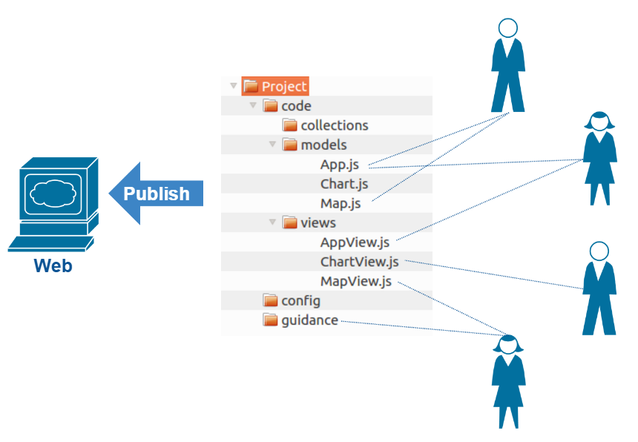
Our typical scenario in App-Dev

Slide 5
Typical scenario publishing to web

Slide 6
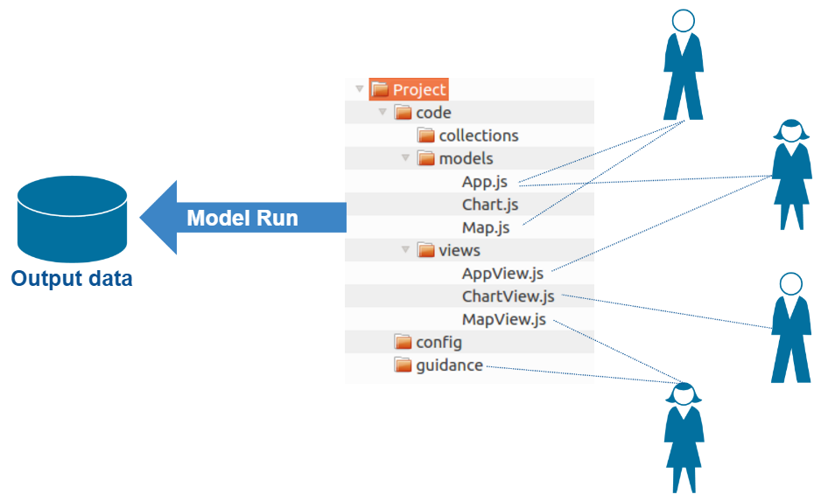
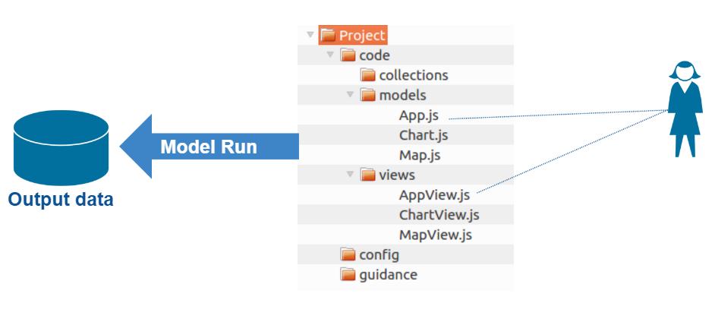
Typical scenario with a model run?

Slide 7
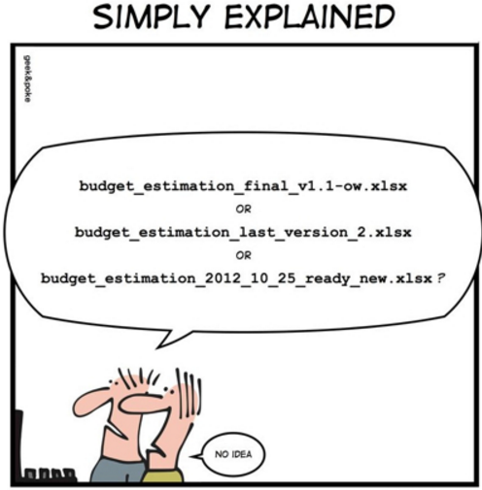
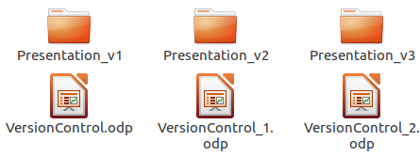
Home grown version control
Naming conventions on files or folders
Simple
Error prone
Redundancy

Slide 8
What do you want from version control?
Recovery
Reproducibility
Safety and resilience
Publication requirement
Review changes
Audit
Traceability
Experiments on code
Notes:
Recover
Audit
Resilient
Easy to use
Unobtrusive
- fast
- efficient at storing changes (doesn’t eat up storage)
- does not impose a way of working
Does not lock files being edited – ie no one is blocked from editing a file
Platform independent
Well supported (mature forums and tutorials)

Slide 9
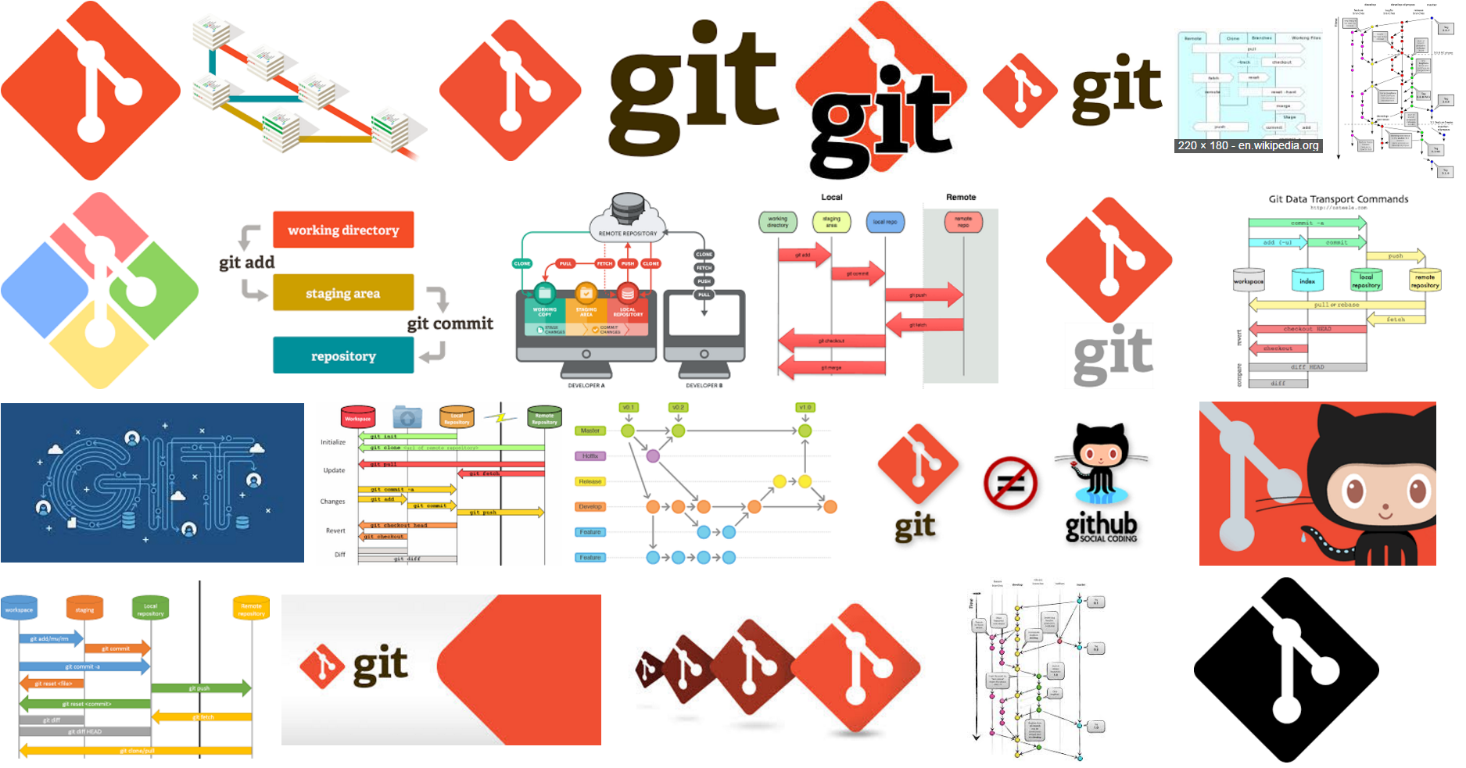
Notes:
‘By far, the most widely used modern version control system in the world today is Git’
Mature
Actively maintained
Fast
Works on many operating systems
Highly flexible – from tiny to large projects, individual use to many users

Slide 10
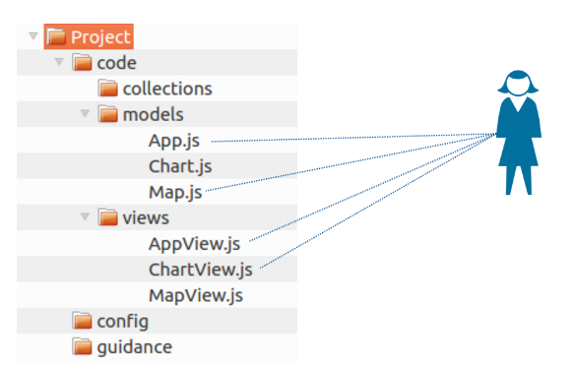





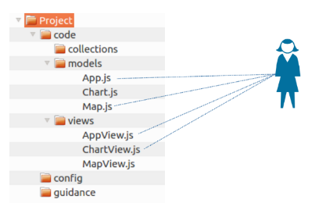

Three learning goals in three sessions
Local version control
Remote hosting
Team working

Slide 11
Session 1: Local version control
Version control a set of files on my local drive
Notes:
Encourages organising work in project folder

Slide 12
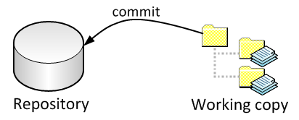
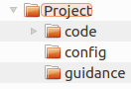
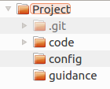
Session 1: Local version control
Git Repository
Your project
Git
repository
added
Enable Git
Notes:
Git repository Is part of the project
It is in the root of the project
Local – therefore no need to be online to get on with work and it is fast

Slide 13
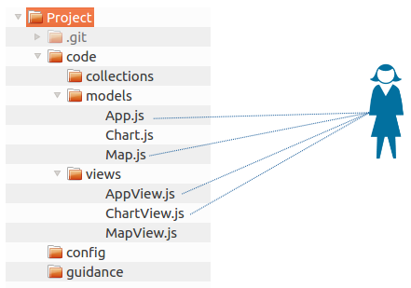
Session 1: Local version control
Commit your edits ‘occasionally’
Add a commit message eg ‘Added a new widget’
Commit
Edits

Slide 14

Session 1: Local version control
Commit
“Added a widget”
Edit
1 Added a widget Jon
Edit
Edit
Edit

Slide 15
Session 1: Local version control
Commit
“Changed charts”
1 Added a widget Jon
Edit
2 Changed charts Jon
Edit
Edit

Slide 16
Session 1: Local version control
Commit
“Updated homepage”
1 Added a widget Jon
Edit
2 Changed charts Jon
Edit
Edit
3 Updated homepage Jon

Slide 17
Session 1: Local version control
Commit
“Moved help page”
1 Added a widget Jon
Edits
2 Changed charts Jon
3 Updated homepage Jon
4 Moved help page Jon

Slide 18
Session 1: Local version control
Commit
“Fixed bug on chart”
1 Added a widget Jon
Edits
2 Changed charts Jon
3 Updated homepage Jon
4 Moved help page Jon
5 Fixed bug on chart Jon

Slide 19
Session 1: Local version control
Commit log
Commit
“Re-styled theme”
1 Added a widget Jon
Edits
2 Changed charts Jon
3 Updated homepage Jon
4 Moved help page Jon
5 Fixed bug on chart Jon
6 Re-styled theme Jon

Slide 20
Session 1: Local version control
Commit log
Snapshots of the state of all files at each commit
+
Who did what
1 Added a widget Jon
2 Changed charts Jon
3 Updated homepage Jon
4 Moved help page Jon
5 Fixed bug on chart Jon
6 Re-styled theme Jon

Slide 21
Session 1: Local version control
App.js
Stage file
1 Added a widget
2 Changed charts
3 Updated homepage
Edits
4 Moved help page
5 Fixed bug on chart
6 Re-styled theme

Slide 22
Session 1: Local version control
Staged file
App.js
1 Added a widget
2 Changed charts
3 Updated homepage
Edits
4 Moved help page
5 Fixed bug on chart
6 Re-styled theme

Slide 23
Session 1: Local version control
App.js
Map.js
Stage file
1 Added a widget
2 Changed charts
3 Updated homepage
Edits
4 Moved help page
5 Fixed bug on chart
6 Re-styled theme

Slide 24
Session 1: Local version control
Staged files
App.js
Map.js
1 Added a widget
2 Changed charts
3 Updated homepage
Edits
4 Moved help page
5 Fixed bug on chart
6 Re-styled theme

Slide 25
Session 1: Local version control
Commit
“Added title”
App.js
Map.js
1 Added a widget Jon
2 Changed charts Jon
3 Updated homepage Jon
Edits
4 Moved help page Jon
5 Fixed bug on chart Jon
6 Re-styled theme Jon
7 Added title Jon

Slide 26
Session 1: Local version control
AppView.js
MapView.js
Stage files
1 Added a widget Jon
2 Changed charts Jon
3 Updated homepage Jon
Edits
4 Moved help page Jon
5 Fixed bug on chart Jon
6 Re-styled theme Jon
7 Added title Jon

Slide 27
Session 1: Local version control
AppView.js
MapView.js
Commit
“Another change”
App.js
Map.js
1 Added a widget Jon
2 Changed charts Jon
3 Updated homepage Jon
Edits
4 Moved help page Jon
5 Fixed bug on chart Jon
6 Re-styled theme Jon
7 Added title Jon
8 Another change Jon

Slide 28
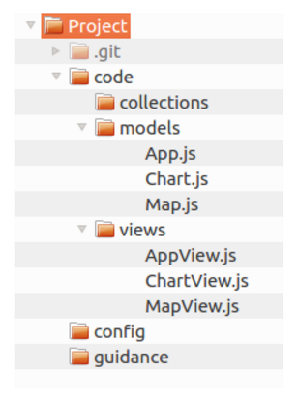
Session 1: Local version control
All files as they were at commit 3
Commit log
1 Added a widget Jon
2 Changed charts Jon
Checkout
3 Updated homepage Jon
4 Moved help page Jon
5 Fixed bug on chart Jon
6 Re-styled theme Jon
7 Added title Jon
8 Another change Jon
Working copy

Slide 29
Session 1: Local version control
Slide about tagging significant versions

Slide 30
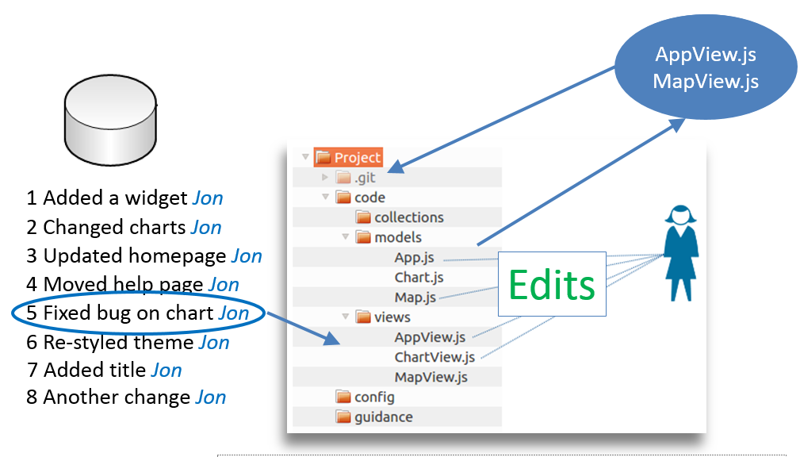
Review
1 Working copy
2 Git repository
3 Stage files
4 Commit files
5 Commit log
6 Checkout
2
4
3
5
2
6
1

Slide 31
Session 2: Remote repository
Others are available
Gitlab
Stash
Bitbucket
etc…
Github

Slide 32
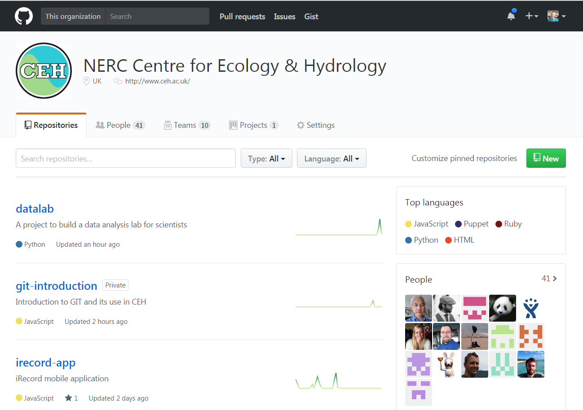
Session 2: Remote repository
CEH github account: https://github.com/NERC-CEH

Slide 33
Session 2: Remote repository
Public and Private repositories
Safe repository
Collaborative
Rich toolset

Slide 34
Session 2: Remote repository
Explanation of keeping in synch with Pull and Push

Slide 35
Session 3: Team working

Slide 36
Session 3: Team working
Branching and merging
Cloning and more on pushing, pulling
Conflict resolution
Pull requests and quality control

Slide 37
More than just version control
Integrates with issue management – branches matched to issues
Workflows triggered by commits and merges – automated unit and integration tests, deployment to servers
Open sourcing promoting collaboration, high quality and reputation
That should whet your apetite

Slide 38
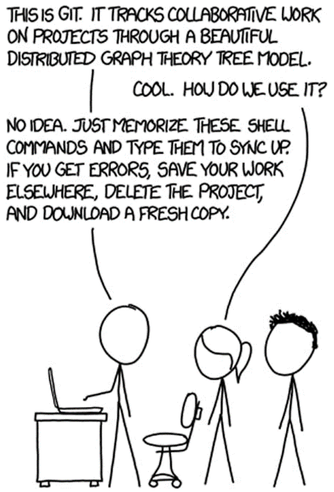
Version Control

Slide 39
Session 1: Local version control
AppView.js
MapView.js
App.js
Map.js
1 Added a widget Jon
2 Changed charts Jon
3 Updated homepage Jon
Edits
4 Moved help page Jon
5 Fixed bug on chart Jon
6 Re-styled theme Jon
7 Added title Jon
8 Another change Jon

